Slide 1
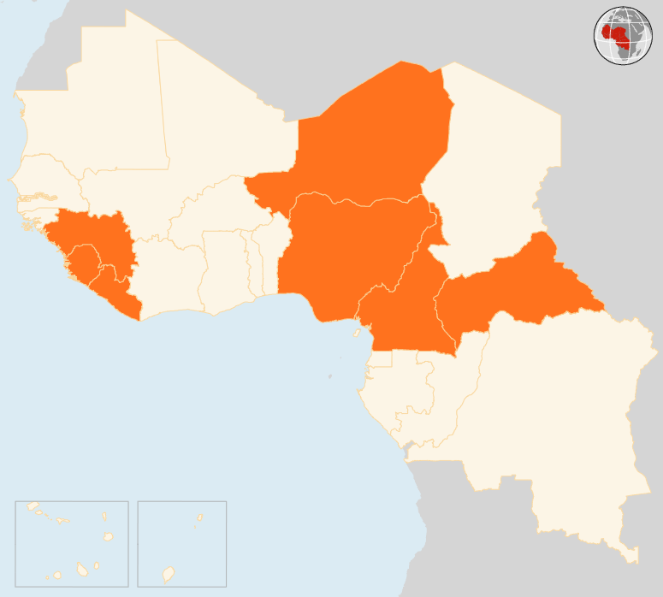

27 October – 02 Nov 2015
CAMEROON
21,000 PEOPLE AFFECTED BY FLOODS IN THE FAR NORTH
According to a field assessment report by MSF released on 29 October, around 21,000 people have been affected by floods in the Zina locality in Cameroon’s Far North region.
CENTRAL AFRICAN REPUBLIC (CAR)
AT LEAST 10 KILLED AMIDST RENEWED VIOLENCE
On 2 November, one person was killed in the capital Bangui by armed men, who set fire to scores of homes in the city. Hundreds of people fled their homes in the capital on the same day following an attack on the PK-5 neighbourhood. Since 26 October, at least 10 people have been killed and more than 30 wounded in Bangui.
NIGER
THOUSANDS MARCH TO DENOUNCE VOTE PREPARATIONS
On 1 November, thousands of anti-government protesters marched in Niger's capital to denounce what they say are irregularities in voter lists ahead of presidential elections. In February 2016 President Mahamadou Issoufou is expected to seek a second five-year mandate.
NIGERIA
338 HOSTAGES FREED
On 27 October, 338 people held captive by Boko Haram were freed when troops raided a camp in Bulajilin and Manawashe villages on the edge of Sambisa Forest in Borno State. The former captives, comprising eight men, 138 women and 192 children, were taken to Mubi in Adamawa State by the military.
EVD REGIONAL
1 NEW CASE IN GUINEA
Guinea recorded one new Ebola case on 30 October in a new-born baby whose mother is confirmed to be infected with Ebola. If no new cases are reported, Sierra Leone will be declared Ebola free on 7 November. As of 1 November, Liberia has reached day 60 of the 90 days of active surveillance and has been Ebola free since 3 September.
NIGER
PROTESTS DENOUNCE VOTE PREPARATIONS
NIGERIA
338
HOSTAGES FREED
CAR
10
KILLED IN ATTACKS
EVD REGIONAL
1
NEW CASE IN GUINEA
CAMEROON
21k
AFFECTED BY FLOODS
Creation date: 04 November 2015 Map data sources: UNCS, DevInfo, OCHA. Feedback: ocharowca@un.org
The boundaries and names shown and the designations used on this map do not imply official endorsement or acceptance by the United Nations.

